Slide 2
Opening Prayer

Slide 3
Call to
Worship

Slide 4
Call to Worship
Leader: This is the day that the Lord has made
People: Let us rejoice and be glad in it.
Leader: This is none other than the house of God,
People: and this is the gate of heaven.
Leader: Enter his gate with thanksgiving,
and his courts with praise!
People: Give thanks to him, bless his name! Amen!!

Slide 5
Opening Songs
(1) “Jesus Loves Me” https://www.youtube.com/watch?v=U-ryg9plBM4
(2) “Thankful” https://www.youtube.com/watch?v=U_ewLEvA8_o

Slide 6
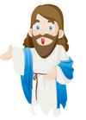
Scripture Reading
(Genesis 1:1-19)

Slide 7
¹ In the beginning God created the heavens and the earth. ² Now the earth was formless and empty,
darkness was over the surface of the deep, and the
Spirit of God was hovering over the waters.
³ And God said, “Let there be light,” and there was light. ⁴ God saw that the light was good, and he separated the light from the darkness. ⁵ God called
the light “day,” and the darkness he called “night.”
And there was evening, and there was morning—the first day.

Slide 8
⁶ And God said, “Let there be a vault between the
waters to separate water from water.” ⁷ So God made the vault and separated the water under the vault from the water above it. And it was so. ⁸ God called the vault
“sky.” And there was evening, and there was morning—the second day.
⁹ And God said, “Let the water under the sky be gathered to one place, and let dry ground appear.”
And it was so. ¹⁰ God called the dry ground “land,”
and the gathered waters he called “seas.” And God saw that it was good.

Slide 9
¹¹ Then God said, “Let the land produce vegetation: seed-bearing plants and trees on the land that bear fruit with seed in it, according to their various kinds.” And it was so. ¹² The land produced vegetation: plants bearing seed according to their kinds and trees bearing fruit with seed in it according to their kinds. And God saw that it was good.
¹³ And there was evening, and there was morning—the third day.
¹⁴ And God said, “Let there be lights in the vault of the sky to separate the day from the night, and let them serve as signs to mark sacred times, and days and years, ¹⁵ and let them be lights
in the vault of the sky to give light on the earth.” And it was so.

Slide 10
¹⁶ God made two great lights—the greater light to
govern the day and the lesser light to govern the
night. He also made the stars. ¹⁷ God set them in the
vault of the sky to give light on the earth, ¹⁸ to govern
the day and the night, and to separate light from
darkness. And God saw that it was good. ¹⁹ And there
was evening, and there was morning—the fourth day.

Slide 11
Sermon
Pastor Cha

Slide 12
Watching Theme Video
https://www.cokesburykids.com/curriculum~celebrate-wonder

Slide 15
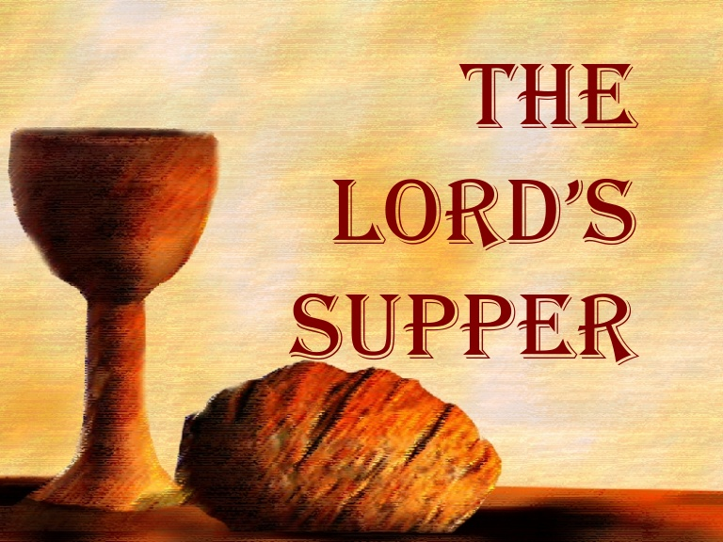
성 찬 식

Slide 16
Gathering
Leader: The Lord be with you.
Children: And also with you.
Leader: Children of God, the Lord calls us
together in the name of Jesus Christ.
And Christ our Lord invites to his
table all who love him, who earnestly
repent of their sin and seek to live
in peace with one another.

Slide 17
Call to Confession
Leader: Children of God, we worship
a holy Lord, but we haven’t lived
holy lives. We need to say
we’re sorry for our sins.

Slide 18
Prayer of Confession
Leader & Children: God, we’re sorry for
the way we’ve hurt you with our thoughts
and words, by bad things we’ve done and
good things we haven’t done.
We haven’t loved you with our whole heart;
we haven’t loved others as much as we
love ourselves. We are very sorry.
Please forgive us because of your Son
Jesus Christ and help us to walk in your
way and bring you glory

Slide 19
Assurance of Pardon
Leader: Children of God, we worship a
merciful Lord whose grace is stronger than
our sin. God promises that when we say
we’re sorry, he will forgive us.
Our sins are forgiven!
Children: Glory to God. Amen.

Slide 20
Institution &
Preparation of the Elements
Leader: On the night in which he gave
himself up for us, he took bread, gave
thanks to you, broke the bread, gave it to
his disciples, and said:
“Take, eat; this is my body which is given
for you. Do this in remembrance of me.
When the supper was over, he took the
cup, gave thanks to you, gave it to his
disciples, and said:

Slide 21
"Drink from this, all of you; this is my blood
of the new covenant, poured out for you
and for many for the forgiveness of sins.
Do this, as often as you drink it, in
remembrance of me."
And so, in remembrance of these your
mighty acts in Jesus Christ, we offer
ourselves in praise and thanksgiving as
a holy and living sacrifice, in union with
Christ's offering for us, as we proclaim
the mystery of faith. Amen.

Slide 22
Communion
– Invitation to the Table
Leader: Children of God, Jesus Christ
invites us to a feast. Anyone who
loves the Lord is welcome.
The table is set. The food is ready.
Come to the Lord's Supper!

Slide 23
Prayer after Communion
Let us pray:
We are not worthy to gather up the crumbs
under your table,
But you always have mercy, and you
welcome us to the table and you feed us
with the bread and the cup.
We thank you, O God!
Amen.

Slide 24
Blessing
The grace of Our Lord
Jesus Christ be with you!
Amen

Slide 25
Bible Activities

Slide 27
Our Father, who art in heaven
hallowed be thy name.
Thy Kingdom come,
thy will be done,
on earth as it is in heaven

Slide 28
Give us this day our daily bread.
And forgive us our trespasses,
as we forgive those who
trespass against us.
And lead us not into temptation,

Slide 29
but deliver us from evil.
For thine is the kingdom,
the power and the glory.
For ever and ever.
Amen.

