Slide 1
RUMC 2020 Summer VBS

Slide 2
Day 3
Jesus’ power
helps us be bold

Slide 3
Opening Prayer

Slide 4
Sing & Praise!
(1) Your Power Will Pull Us Through
https://www.youtube.com/watch?v=4xS48-KihC0
(2) We Can Trust Him https://www.youtube.com/watch?v=VmiL38ezUWk

Slide 5
Bible Adventure

Slide 6
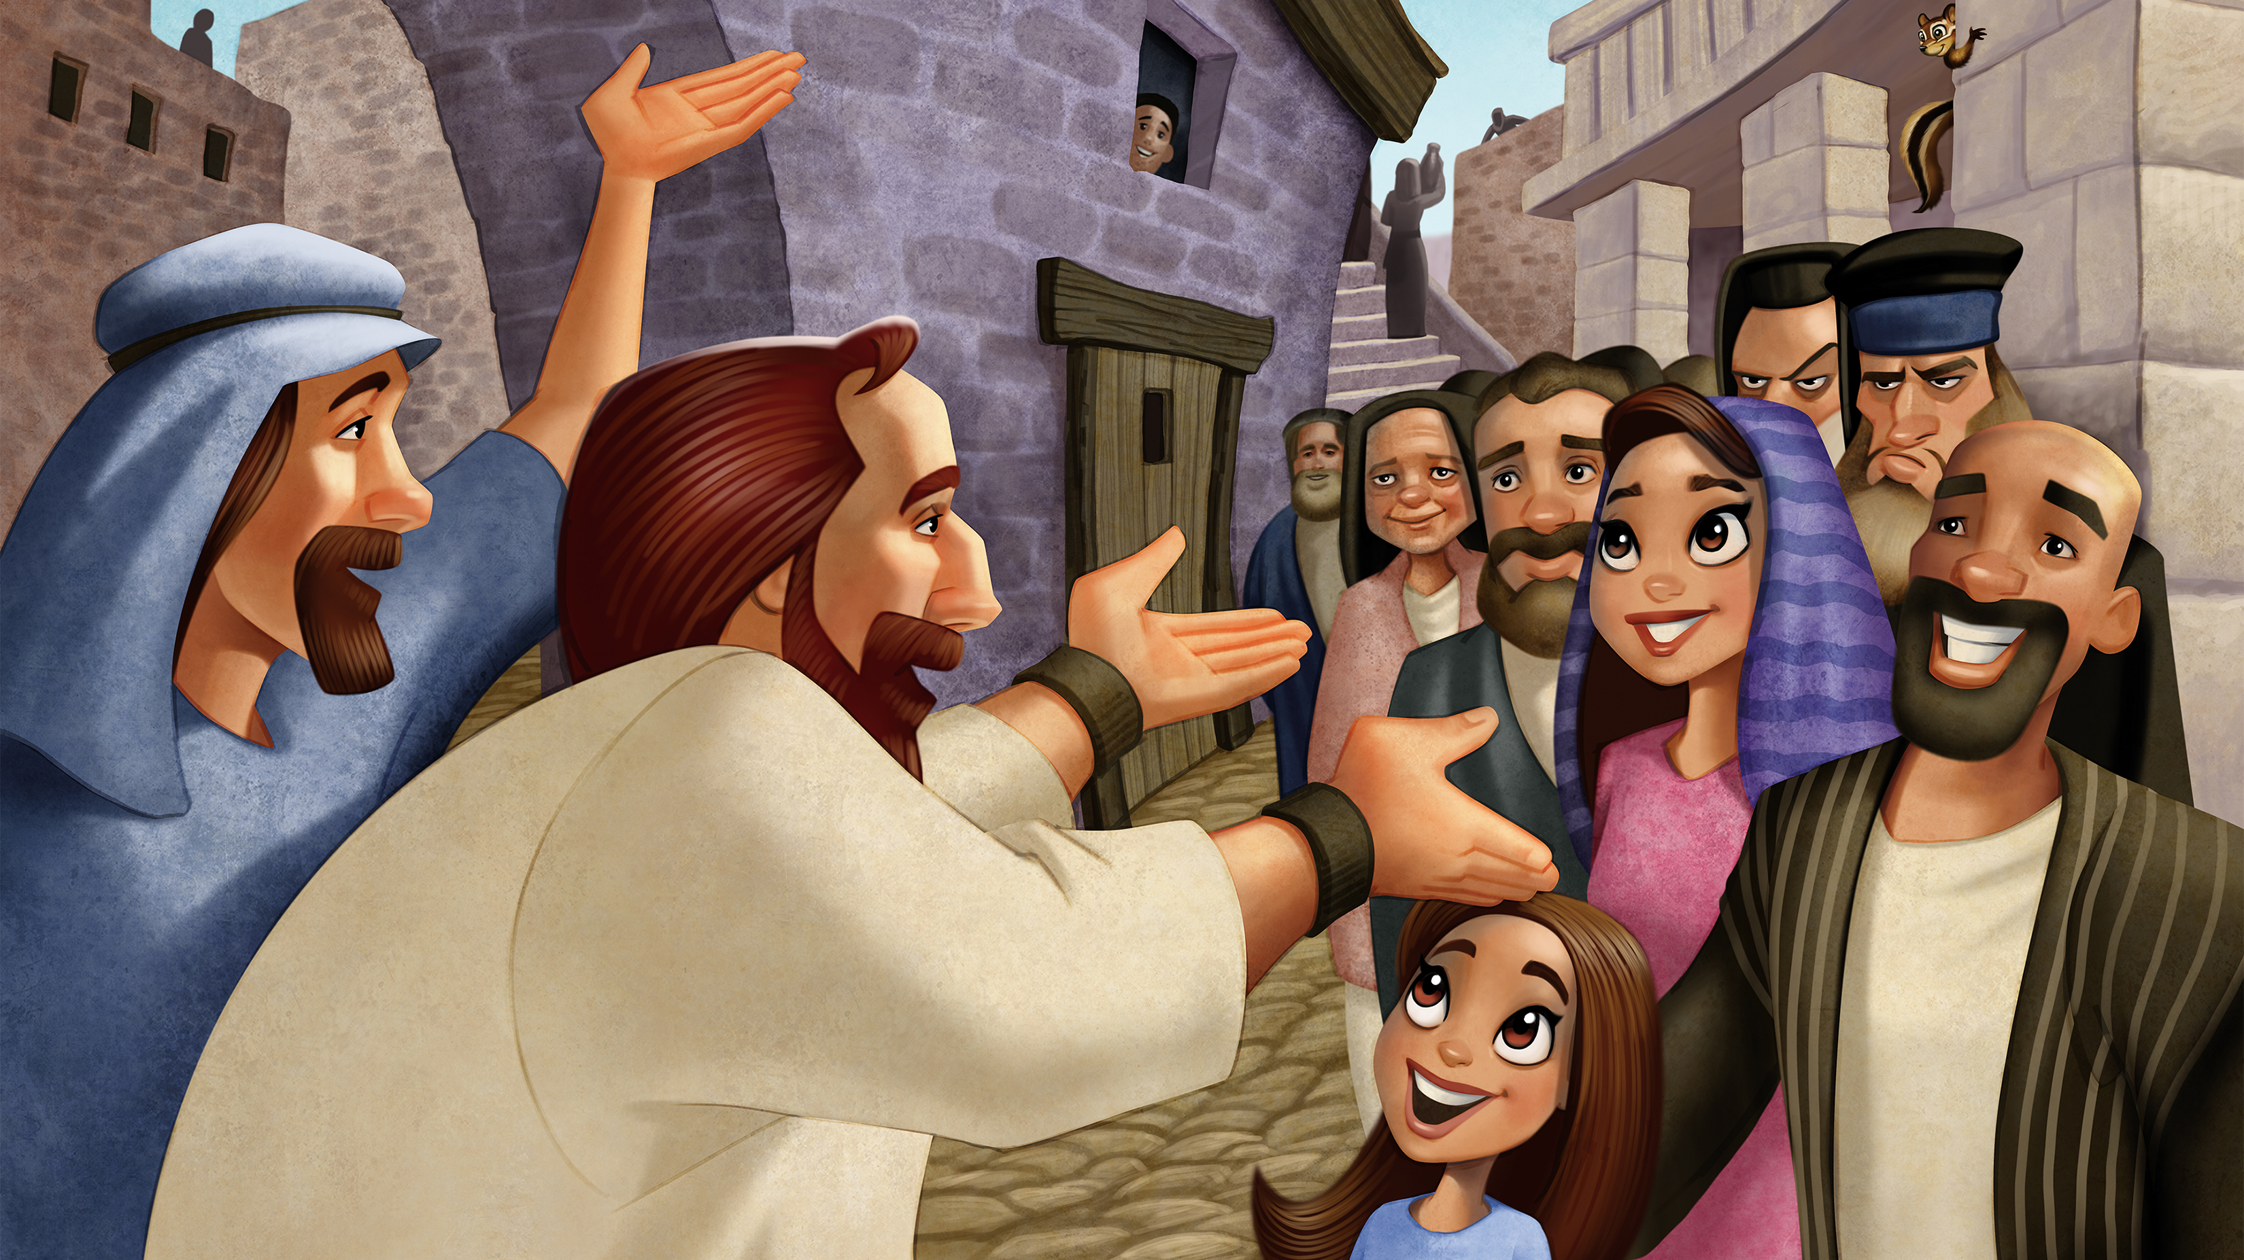

Slide 7
Memory Verse:
“He gives power to the weak
and strength to the powerless.”
(Isaiah 40:29)

Slide 8
Bible Story: Acts 27
Peter and John teach about Jesus.
(Acts 3:1-4:31)
Scripture:
https://www.biblegateway.com/passage/?search=Acts+3%3A1-4%3A31&version=NIV
Story Video:
https://www.youtube.com/watch?v=rQTFNyctPVU

Slide 9
Buzzly’s Buddies
Sierra The Mountain Lion
Watch Video:
https://www.youtube.com/watch?v=W5Zg_aX5who

Slide 10
Imagination Station

Slide 11
KidVid Cinema
https://www.youtube.com/watch?v=BLHOknh_Ml8

Slide 13
Our Father, who art in heaven
hallowed be thy name.
Thy Kingdom come,
thy will be done,
on earth as it is in heaven

Slide 14
Give us this day our daily bread.
And forgive us our trespasses,
as we forgive those who
trespass against us.
And lead us not into temptation,

Slide 15
but deliver us from evil.
For thine is the kingdom,
the power and the glory.
For ever and ever.
Amen.

