Slide 1

RUMC 2020 Summer VBS

Slide 2

Day 1
Jesus’ power helps
us do hard things!!

Slide 3
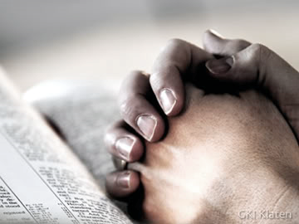
Opening Prayer

Slide 4

Opening Songs
(1) Your Power Will Pull Us Through
https://www.youtube.com/watch?v=4xS48-KihC0
(2) This Train Is Bound For Glory
https://www.youtube.com/watch?v=cSkTGbEUuIU

Slide 5
Memory Verse:
“For I can do everything through
Christ, who gives me strength.”
(Philippians 4:13)

Slide 6
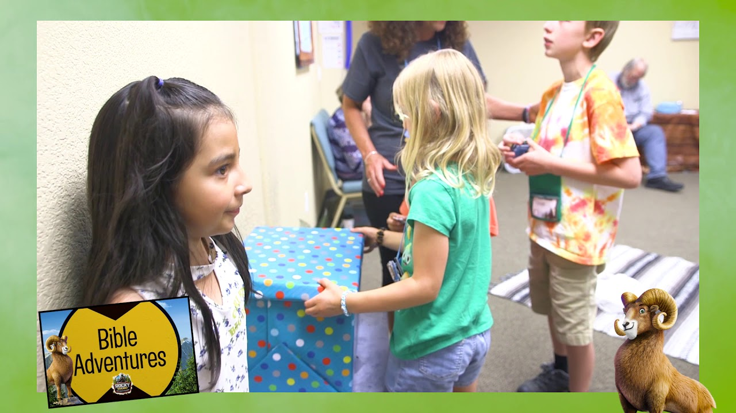
Bible Adventure

Slide 7
Bible Story: Acts 9:1-19
- Ananias helps Saul.
Scripture:
https://www.biblegateway.com/passage/?search=Acts%209%3A1-19&version=NIV
Story Video:
https://www.youtube.com/watch?v=oi95cv0tk9Q

Slide 8
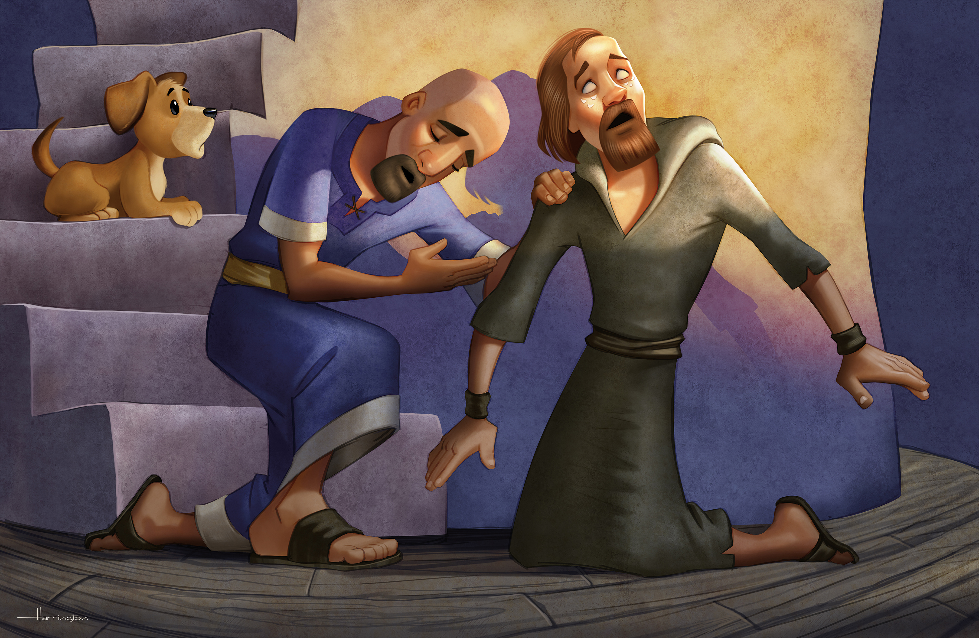

Slide 9
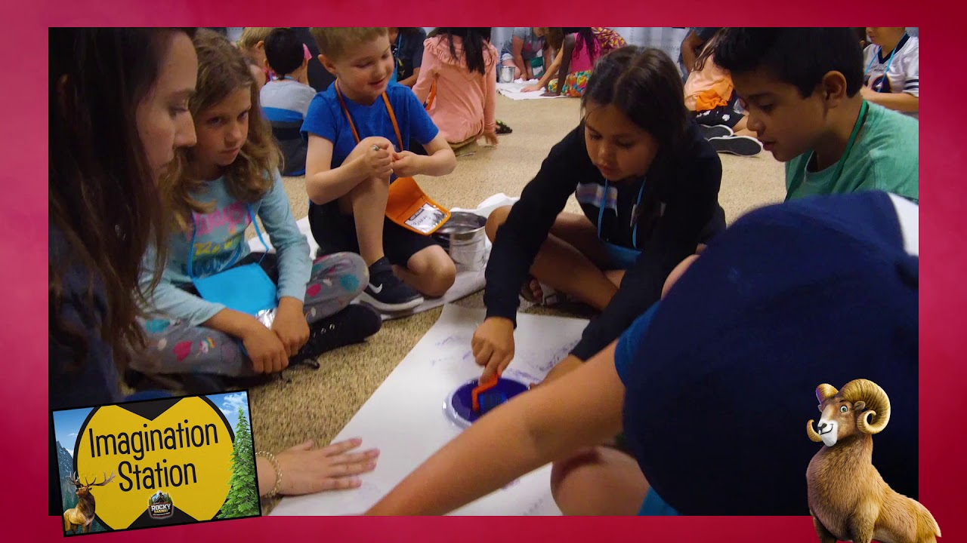
Imagination Station

Slide 10

KidVid Cinema
https://www.youtube.com/watch?v=8jkg_5E73Js

Slide 11


Slide 12
Our Father, who art in heaven
hallowed be thy name.
Thy Kingdom come,
thy will be done,
on earth as it is in heaven

Slide 13
Give us this day our daily bread.
And forgive us our trespasses,
as we forgive those who
trespass against us.
And lead us not into temptation,

Slide 14
but deliver us from evil.
For thine is the kingdom,
the power and the glory.
For ever and ever.
Amen.

